Slide 1

CHAPTER 4 STRUCTURES
CHAPTER OUTLINE
4/1 Introduction
4/2 Plane Trusses
4/3 Method of Joints
4/4 Method of Sections
4/5 Space Trusses
4/6 Frames and Machines
Myimagefiles/Alamy Stock Photo

Slide 2
Article 4/1 Introduction
Reminders from Chapter 3
Equilibrium of a Single Rigid Body
Free-Body Diagrams of an Entire Structure
Application of Force and Moment Equations of Equilibrium
Purpose of Chapter 4
Equilibrium of Several Rigid Bodies
Free-Body Diagrams of Portions of a Structure
Application of Force and Moment Equations of Equilibrium
Application of Newton’s 3rd Law

Slide 3
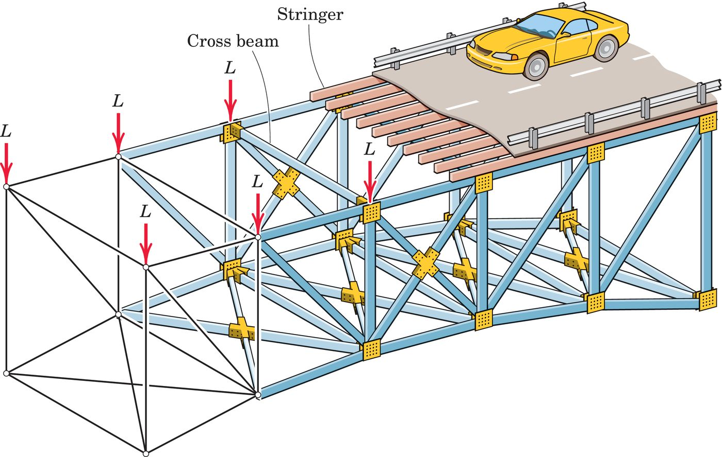
Article 4/2 Plane Trusses
Introduction
Previously, we have been been concerned with the external forces acting on a body. In this section, however, we study the forces internal to a structure. Determining the load on each internal member of a truss or frame allows one to then design that particular member.
Example Bridge Truss
Each vertical side of the structure is a plane truss, which is a framework composed of members joined at their ends. A simplified model is indicated at the left end of the illustration. The forces L represent the portions of the weights of the roadway, vehicles, stringers, and cross beams which are transferred to the truss joints. Note that joints are modeled as simple pins, even though they might actually be gusset plates or welded connections.

Slide 4
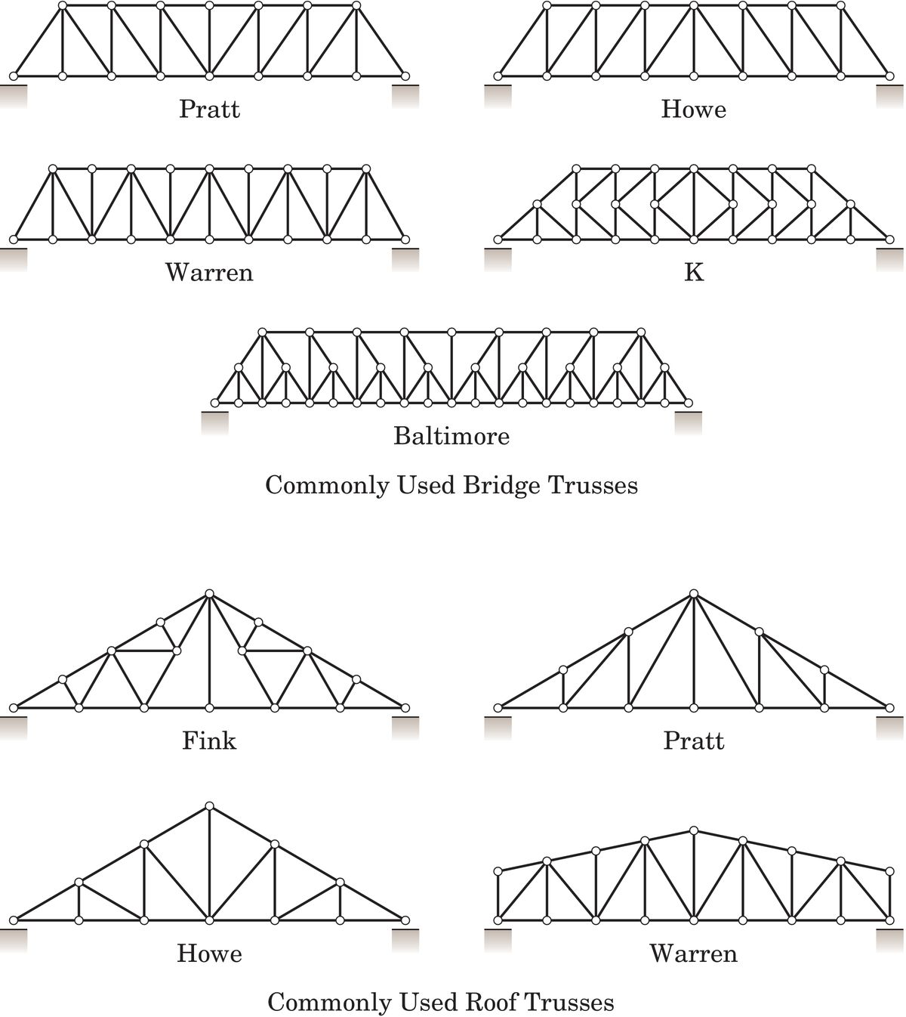
Article 4/2 – Common Truss Shapes (1 of 2)
Commonly Used Bridge Trusses

Slide 5
Article 4/2 – Common Truss Shapes (2 of 2)
Commonly Used Roof Trusses

Slide 6
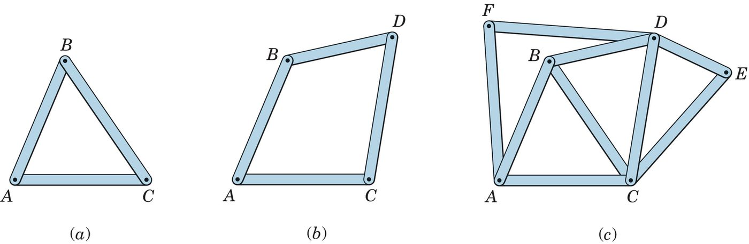
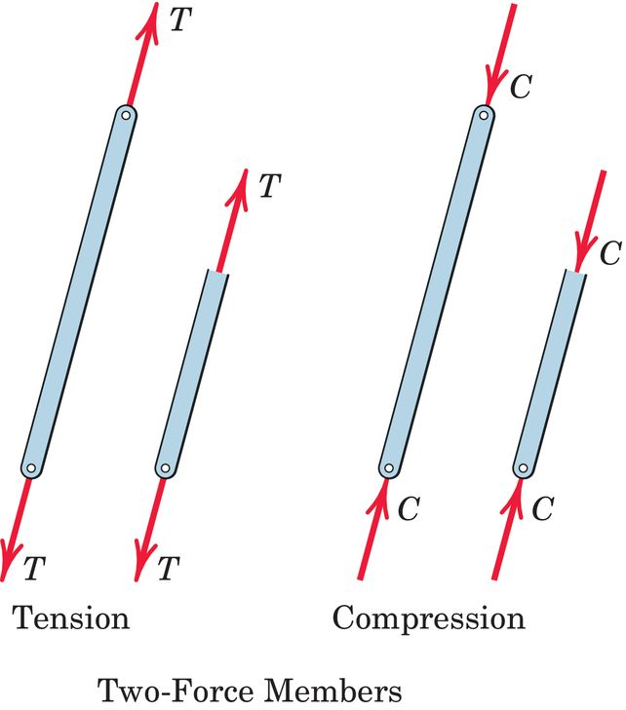
Article 4/2 – Features of Simple Trusses (1 of 2)
Simple Trusses
Rigid
Basic Element
Two-Force Members
Weight of Truss Members
Location of Applied Loads

Slide 7
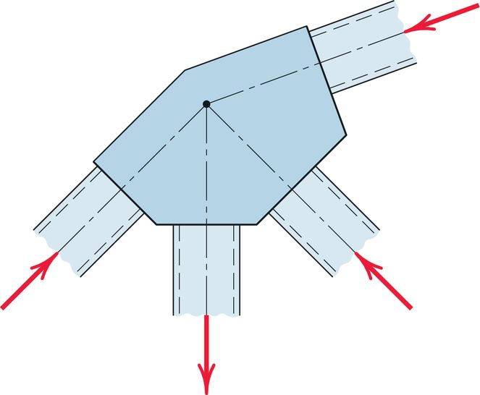
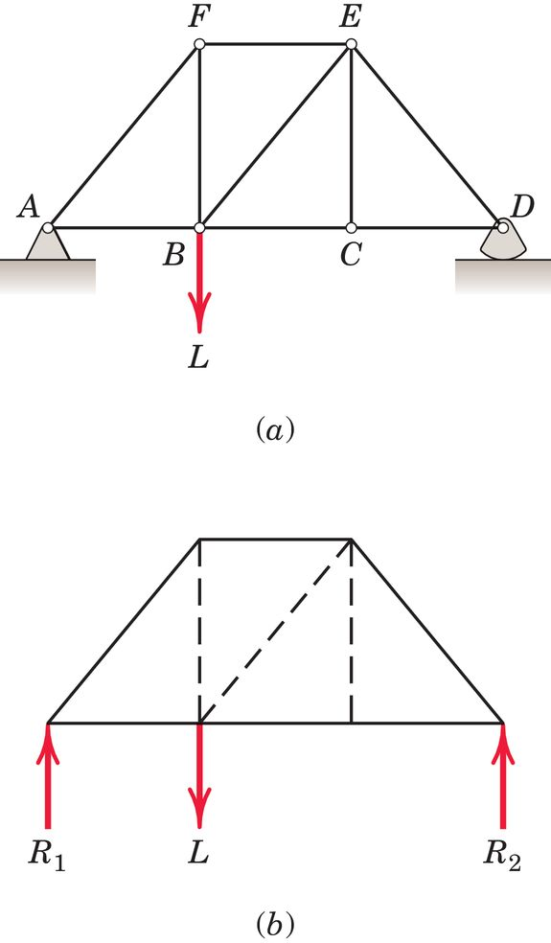
Article 4/2 – Features of Simple Trusses (2 of 2)
Simple Trusses (cont.)
Connections between Members
Support Representation
The trusses in this text are statically determinant, which means a complete application of Newton’s First Law will provide the solution for all unknown reactions and internal forces. Trusses that cannot be solved in this fashion are statically indeterminate, and information regarding the deformation of the members must be included to obtain the solution.

Slide 8
Article 4/3 Method of Joints
Features of the Method
Looks at Equilibrium of Each Joint Connection
Limited to Force Summation Equations of Equilibrium at each Joint
Limited to Finding Two Unknown Reactions at a Time
Proceeds Systematically Across the Truss
Very Methodical and Easy to Utilize
Very Useful for Finding all of the Truss-Member Forces

Slide 9
Article 4/3 – Overview of Method of Joints
General Procedure
In general, find the external reactions first (this may or may not be necessary).
Start by analyzing a joint where at least one known applied load acts, and at most, only two unknown truss forces are present.
Apply a sum of forces in an appropriate x- and y-direction at this joint.
Draw members in tension or compression, and stay consistent with your choice until you move to the next joint.
Solve the equilibrium equations for the unknown truss forces.
Move to the next adjacent joint and repeat the process.

Slide 10
Article 4/3 – Illustration of Method of Joints (1 of 3)
Determine the force in each member of the truss.
Determine the external reactions

Slide 11
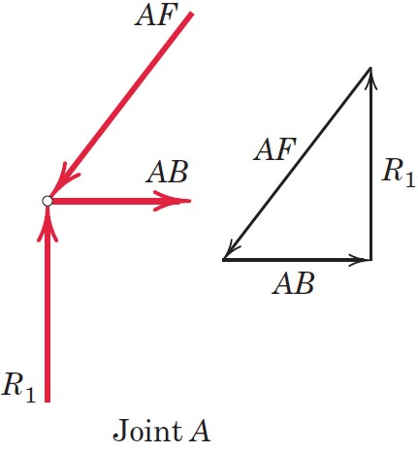
Article 4/3 – Illustration of Method of Joints (2 of 3)
Determine the force in each member of the truss.
Determine the external reactions.
Start at a joint with only two unknowns, joint A.
Draw the free-body diagram and apply equilibrium equations.

Slide 12
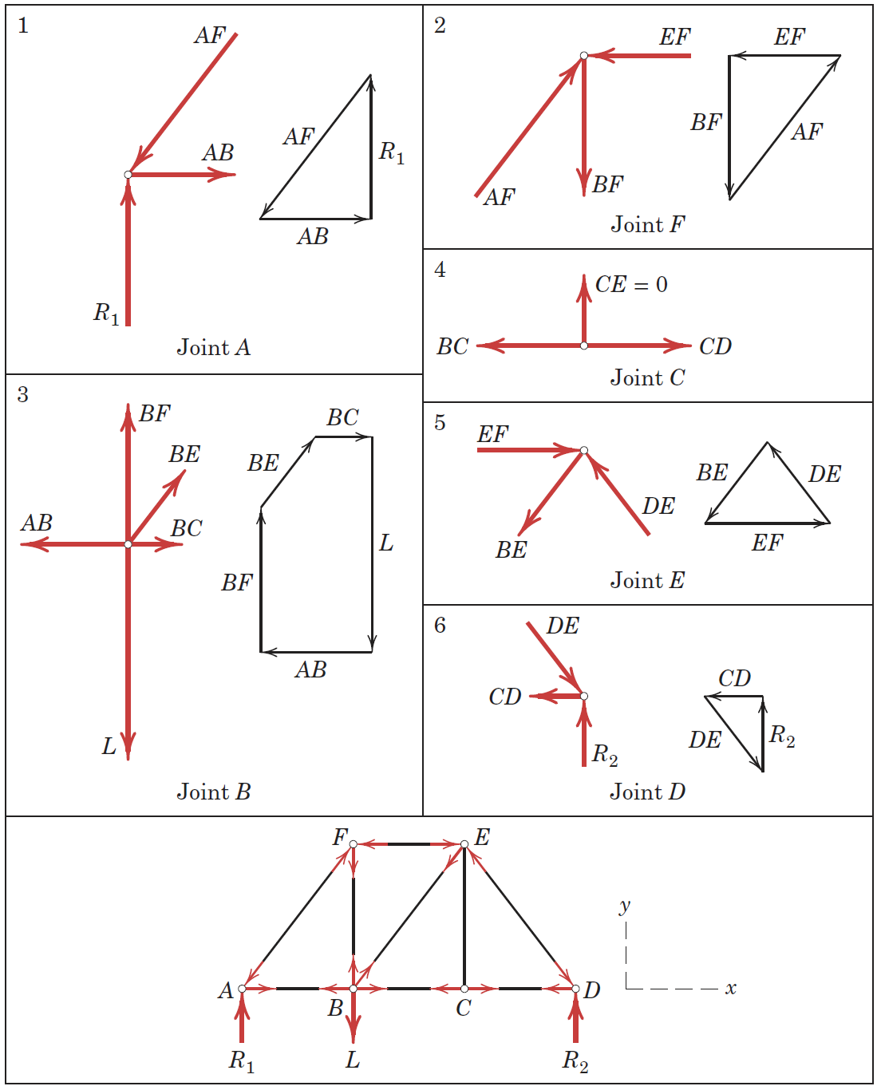
Article 4/3 – Illustration of Method of Joints (3 of 3)
Determine the force in each member of the truss.
Determine the external reactions.
Start at a joint with only two unknowns, Joint A.
Draw the free-body diagram and apply equilibrium equations.
Proceed to the next joint and repeat the process.
Be careful with the signs of the members and indicate if they are in tension or compression.

Slide 13
Article 4/3 – Internal and External Redundancy
External Redundancy
Internal Redundancy
Checking for Internal Statical Determinacy
Number of Internal Members, m
Number of Joint Connections, j
Truss is statically determinate internally if… m + 3 = 2j
Comment on Stability

Slide 14
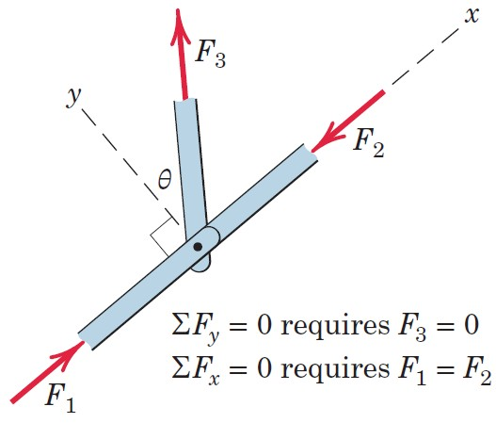
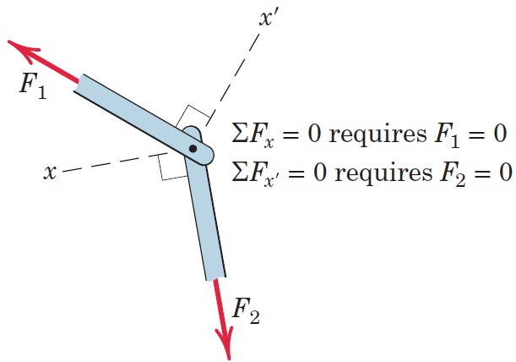
Article 4/3 – Special Conditions in Trusses (1 of 3)
Condition 1: Three Members at a Joint, Two are Collinear
Condition 2: Two Members at a Joint, Not Collinear

Slide 15
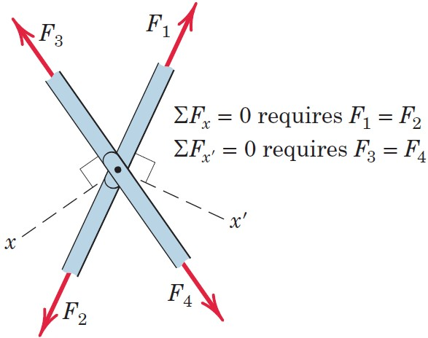
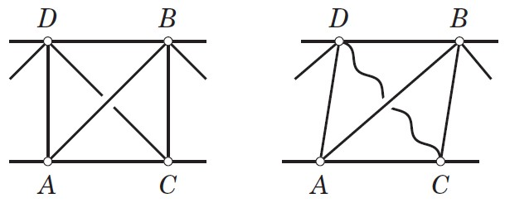
Article 4/3 – Special Conditions in Trusses (2 of 3)
Condition 3: Two Pairs of Collinear Members at a Joint
Condition 4: Cross Bracing

Slide 16
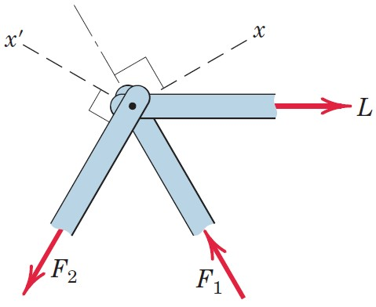
Article 4/3 – Special Conditions in Trusses (3 of 3)
Condition 5: Avoiding Simultaneous Equations
Summing Forces along x-Axis Eliminates F₁
Summing Forces along x′-Axis Eliminates F₂

Slide 17
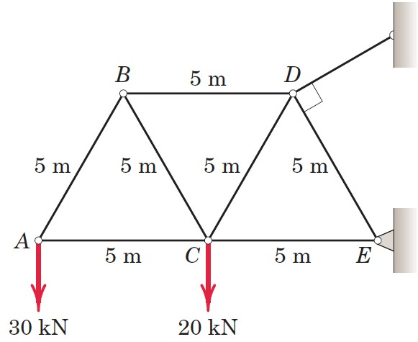
Article 4/3 – Sample Problem 4/1 (1 of 4)
Problem Statement
Compute the force in each member of the loaded cantilever truss by the method of joints.

Slide 18
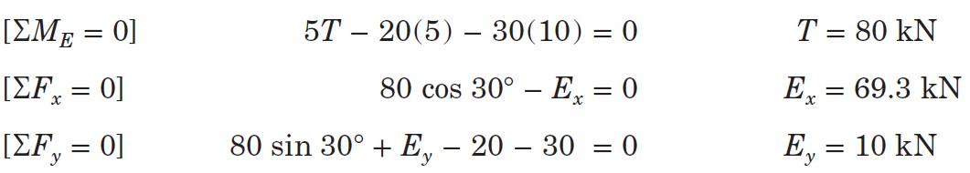
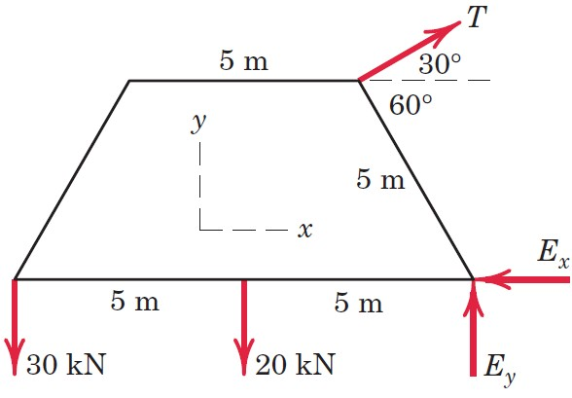
Article 4/3 – Sample Problem 4/1 (2 of 4)
Find External Reactions

Slide 19
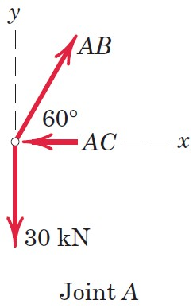
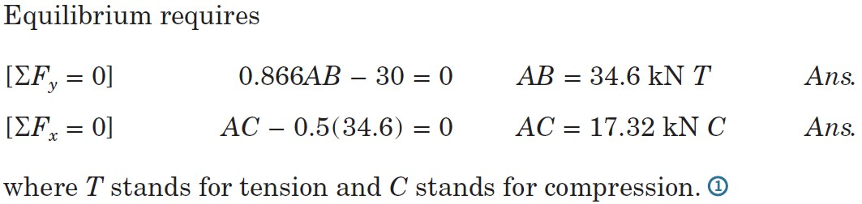
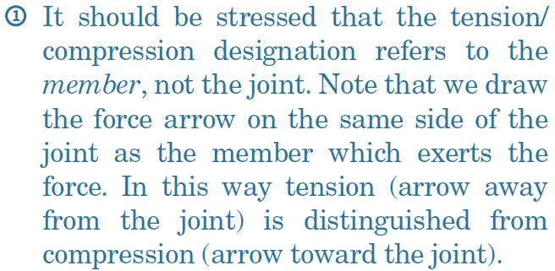
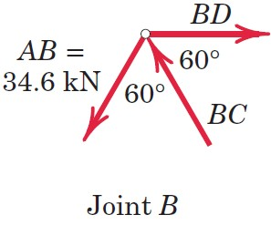
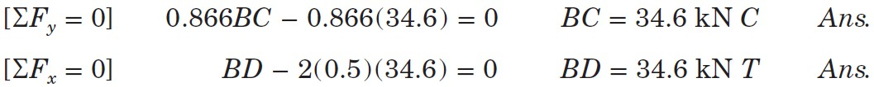
Article 4/3 – Sample Problem 4/1 (3 of 4)
Equilibrium of Joint A
Equilibrium of Joint B

Slide 20
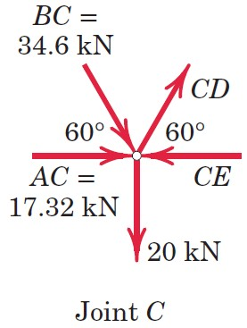
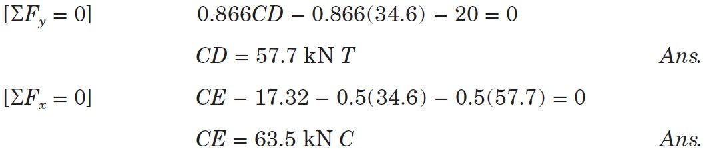
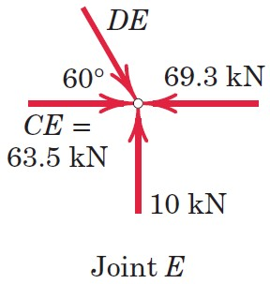
Article 4/3 – Sample Problem 4/1 (4 of 4)
Equilibrium of Joint C
Equilibrium of Joint E

Slide 21
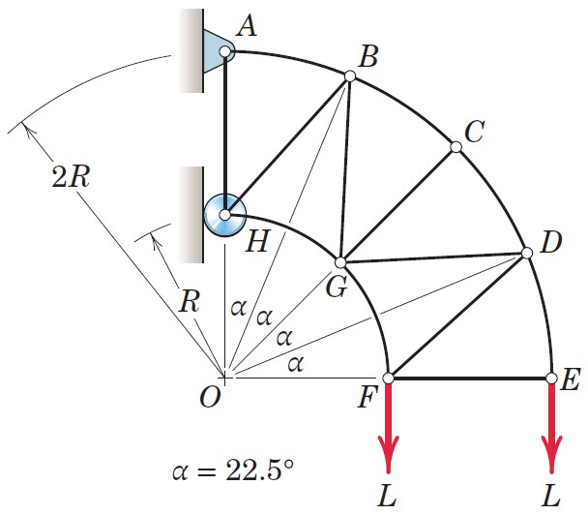
Article 4/3 – Sample Problem 4/2 (1 of 4)
Problem Statement
The simple truss shown supports the two loads, each of magnitude L. Determine the forces in members DE, DF, DG, and CD.

Slide 22
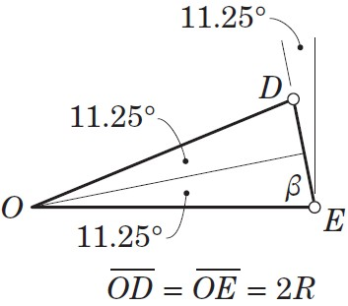
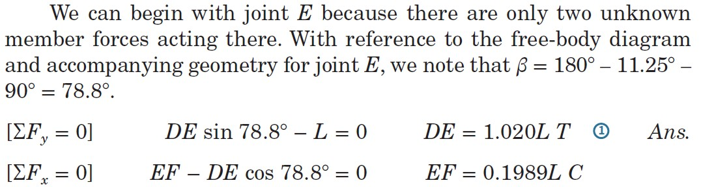
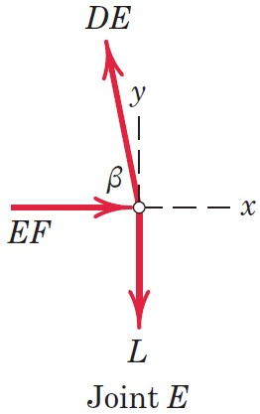
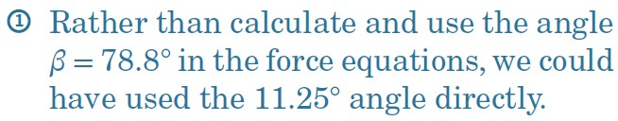
Article 4/3 – Sample Problem 4/2 (2 of 4)
Geometry of Joint E
Equilibrium of Joint E

Slide 23
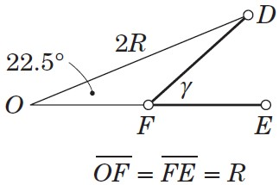
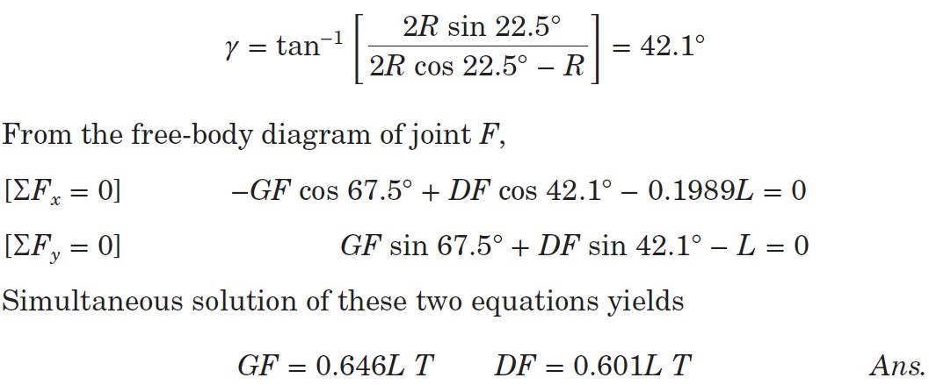
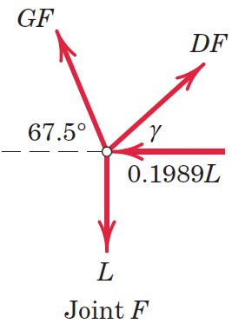
Article 4/3 – Sample Problem 4/2 (3 of 4)
Geometry of Joint F
Equilibrium of Joint F

Slide 24
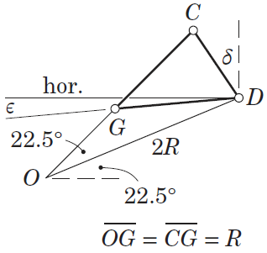
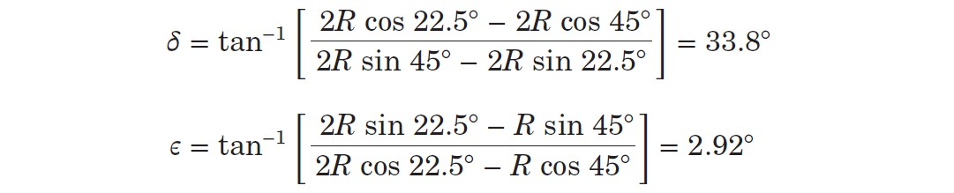
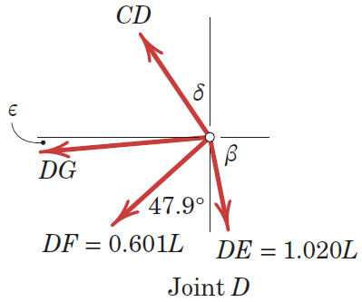
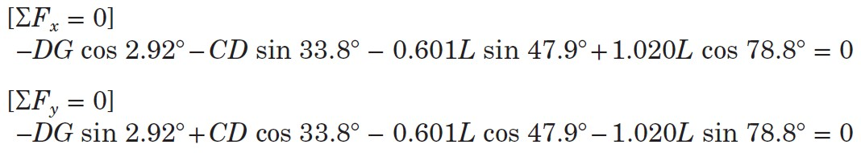
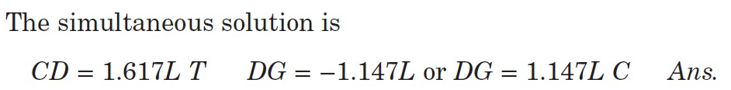
Article 4/3 – Sample Problem 4/2 (4 of 4)
Geometry of Joint D
Equilibrium of Joint D

Slide 25
Article 4/4 Method of Sections
Differences with the Method of Joints
Can utilize the moment equation of equilibrium.
Can analyze an entire section of a truss.
Can determine the force in almost any desired member directly.
A Word of Caution
Don’t abandon the method of joints.
Usually limited to cutting at most three members at one time.

Slide 26
Article 4/4 – Overview of Method of Sections
General Procedure
In general, find the external reactions first (this may or may not be necessary).
If possible, pass a section (or cut) through the desired member and up to two (2) other unknown members, isolating a portion of the truss.
Apply two-dimensional rigid-body equilibrium equations to the isolated truss portion; e.g., ΣF_{x} = 0, ΣF_{y} = 0, and ΣM_{O} = 0.
Solve for the unknowns.
Note that the methods of sections and joints may be used in combination.

Slide 27
Article 4/4 – Illustration of Method of Sections (1 of 2)
Determine the force in member BE.
Determine the external reactions.

Slide 28
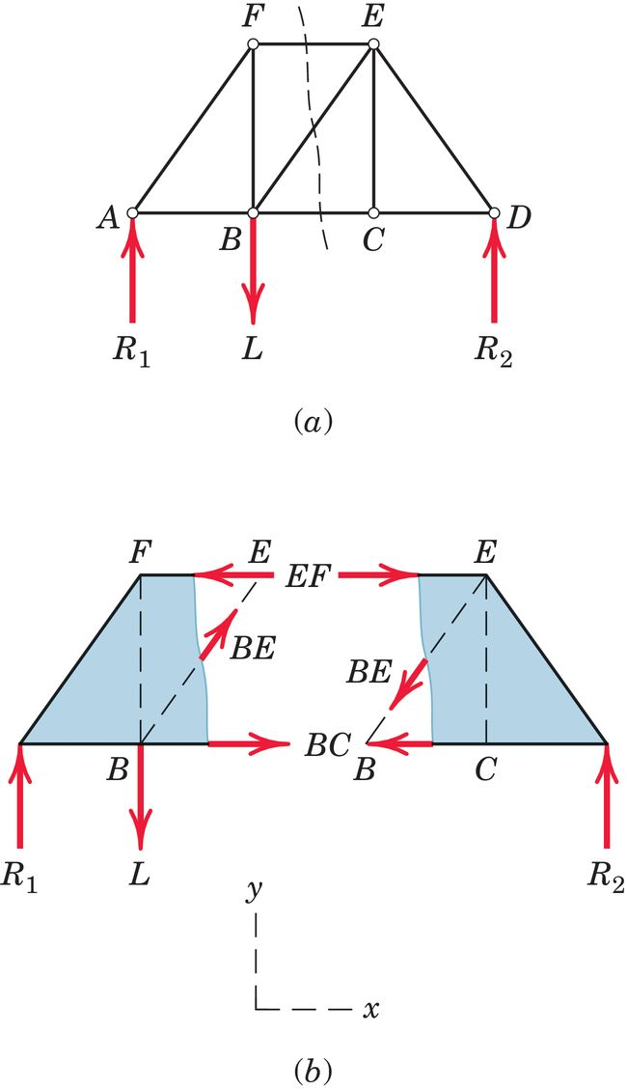
Article 4/4 – Illustration of Method of Sections (2 of 2)
Determine the force in member BE.
Determine the external reactions.
Pass a section through member BE.
Choose either side of the truss.
Apply equilibrium equations.

Slide 29
Article 4/4 – Additional Considerations
Additional Considerations
Consider an entire portion of the truss in equilibrium.
Forces internal to the section are not considered.
Use either portion of the truss after cutting.
Combine with method of joints if necessary.
Select advantageous moment centers.
Stay mindful of assumed directions for unknown forces, tension or compression.

Slide 30
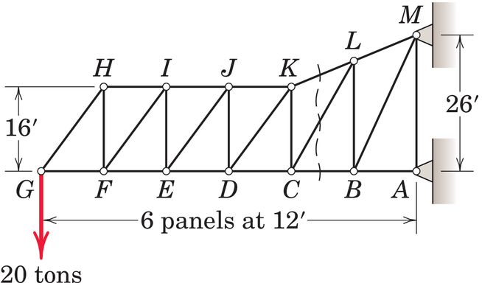
Article 4/4 – Sample Problem 4/3 (1 of 3)
Problem Statement
Calculate the forces induced in members KL, CL, and CB by the 20-ton load on the cantilever truss.

Slide 31
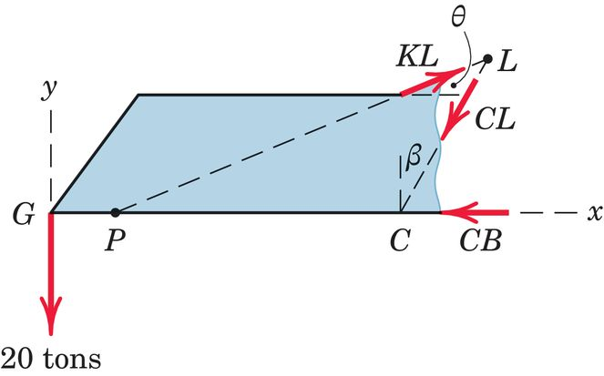
Article 4/4 – Sample Problem 4/3 (2 of 3)
FBD of Section

Slide 32
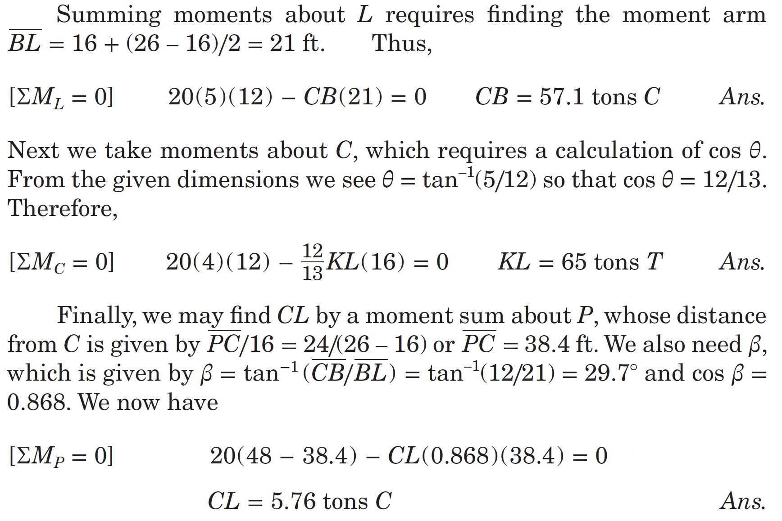
Article 4/4 – Sample Problem 4/3 (3 of 3)
Equilibrium Conditions

Slide 33
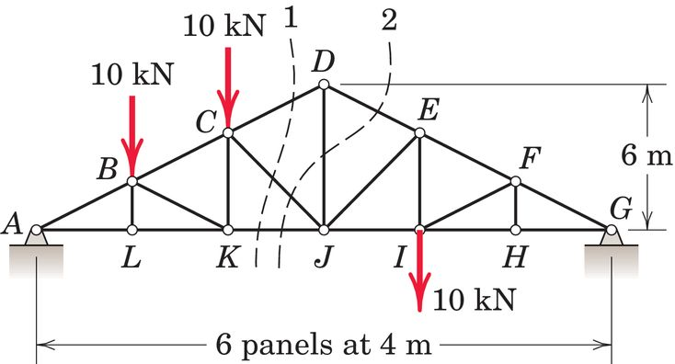
Article 4/4 – Sample Problem 4/4 (1 of 4)
Problem Statement
Calculate the force in member DJ of the Howe roof truss illustrated. Neglect any horizontal components of force at the supports.

Slide 34
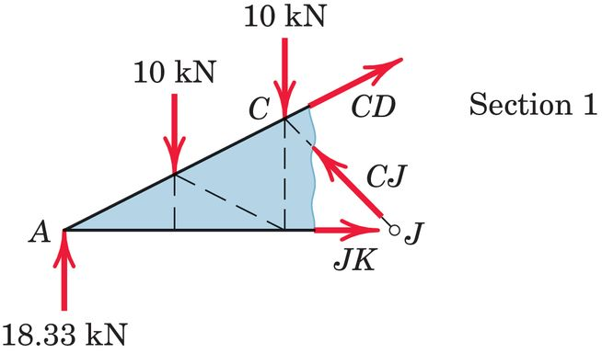
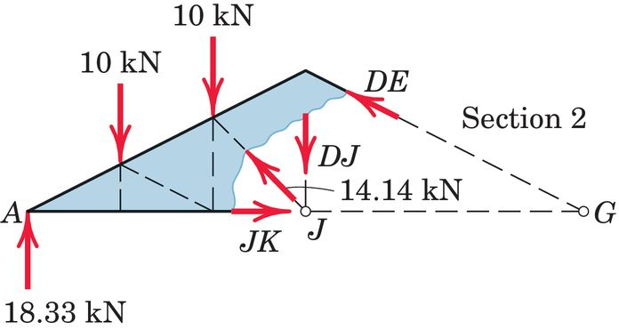
Article 4/4 – Sample Problem 4/4 (2 of 4)
FBD of Section 1
FBD of Section 2

Slide 35
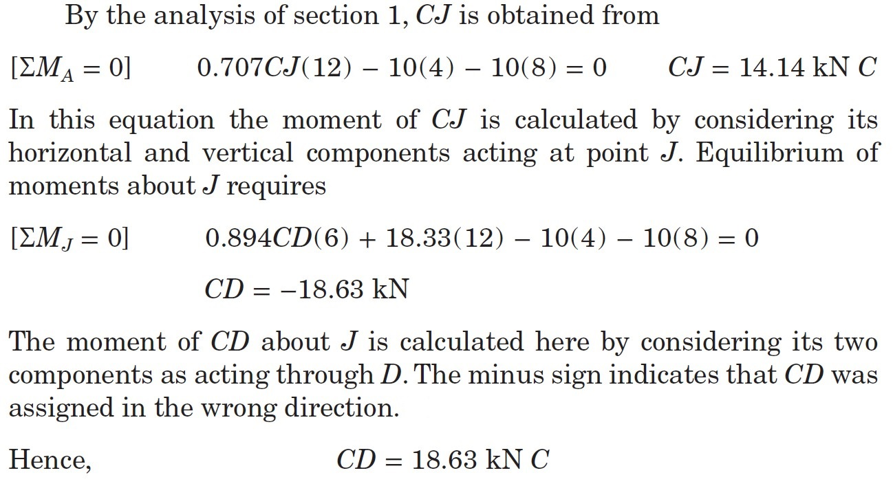
Article 4/4 – Sample Problem 4/4 (3 of 4)
Equilibrium Conditions

Slide 36
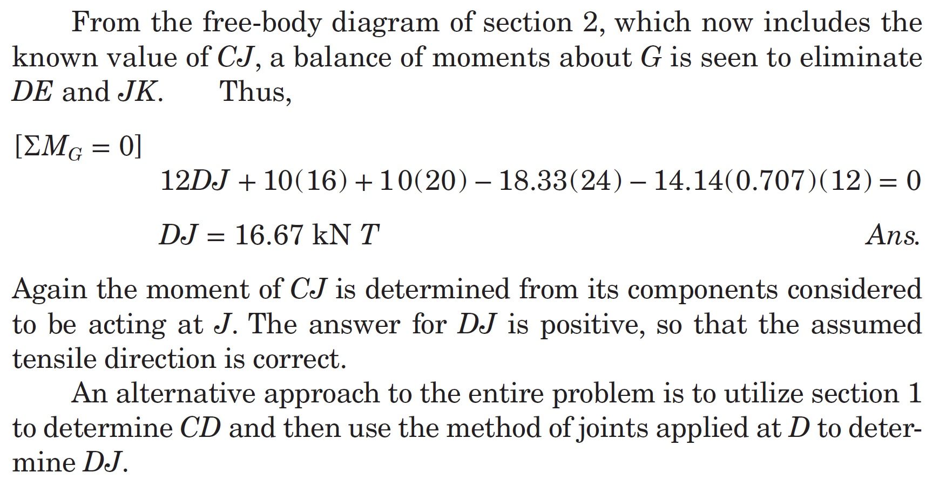
Article 4/4 – Sample Problem 4/4 (4 of 4)
Equilibrium Conditions

Slide 37
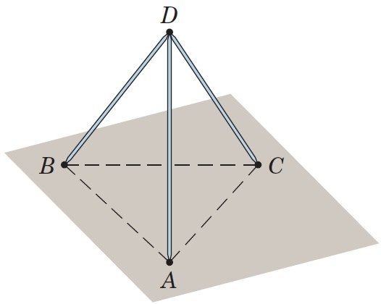
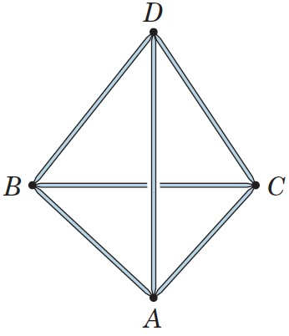
Article 4/5 Space Trusses (1 of 2)
Three-Dimensional Analogue of Plane Truss
Basic Shape is a Tetrahedron
Analysis Utilizes Method of Joints and Method of Sections extended to Three Dimensions
Statically Determinant if… m + 6 = 3j

Slide 38
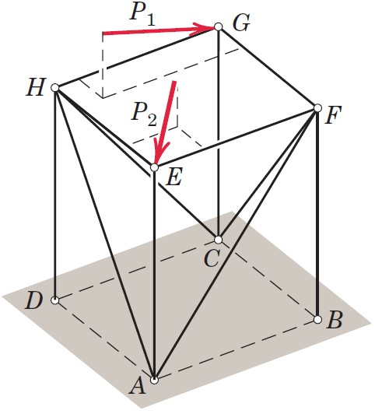
Article 4/5 Space Trusses (2 of 2)
Method of Joints for Space Trusses
Same Basic Procedure as for Plane Trusses
ΣF = 0 at each Joint (ΣF_{x} = 0, ΣF_{y} = 0, and ΣF_{z} = 0)
Limited to Solving Three (3) Unknown Forces at a Time
Method of Joints for Space Trusses
Same Basic Procedure as for Plane Trusses
ΣF = 0 for any Section (ΣF_{x} = 0, ΣF_{y} = 0, and ΣF_{z} = 0)
ΣM = 0 for any Section (ΣM_{x} = 0, ΣM_{y} = 0, and ΣM_{z} = 0)
Limited to Solving Six (6) Unknown Forces at a Time

Slide 39
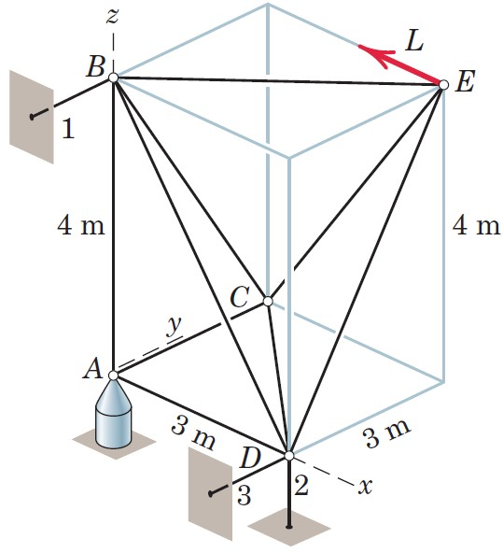
Article 4/5 – Sample Problem 4/5 (1 of 3)
Problem Statement
The space truss consists of the rigid tetrahedron ABCD anchored by a ball-and-socket connection at A and prevented from any rotation about the x-, y-, or z-axes by the respective links 1, 2, and 3. The load L is applied to joint E, which is rigidly fixed to the tetrahedron by the three additional links. Solve for the forces in the members at joint E and indicate the procedure for the determination of the forces in the remaining members of the truss.

Slide 40


Article 4/5 – Sample Problem 4/5 (2 of 3)
Check Determinacy
m + 6 = 3j
9 + 6 = 3(5) True
Free-Body Diagram of Joint E

Slide 41

Article 4/5 – Sample Problem 4/5 (3 of 3)
Equilibrium of Joint E

Slide 42

Article 4/6 Frames and Machines
Definition
A structure is called a frame or machine if at least one of its individual members is a multiforce member. A multiforce member is defined as one with three or more forces acting on it, or one with two or more forces and one or more couples acting on it.
Example – Jaws of Life

Slide 43


Article 4/6 – Types of Structures
Interconnected Rigid Bodies with Multiforce Members
Rigid Noncollapsible
Find external reactions for the entire structure first.
Dismember to find internal reactions.
Look for two-force members.
Nonrigid Collapsible
Dismember the structure first to find internal reactions.
Compute external reactions later.
Look for two-force members.

Slide 44


Article 4/6 – Force Representation and FBDs
Importance of Action-Reaction Pairs
Assumed Force Directions
Vector Notation
Simultaneous Equations

Slide 45

Article 4/6 – Sample Problem 4/6 (1 of 3)
Problem Statement
The frame supports the 400-kg load in the manner shown. Neglect the weights of the members compared with the forces induced by the load and compute the horizontal and vertical components of all forces acting on each of the members.

Slide 46


Article 4/6 – Sample Problem 4/6 (2 of 3)
Free-Body Diagram of Entire Structure (Rigid)
Equilibrium Conditions

Slide 47


Article 4/6 – Sample Problem 4/6 (3 of 3)
Free-Body Diagrams of Individual Pieces
Equilibrium of Member BF

Slide 48

Article 4/6 – Sample Problem 4/7 (1 of 4)
Problem Statement
Neglect the weight of the frame and compute the forces acting on all of its members.

Slide 49


Article 4/6 – Sample Problem 4/7 (2 of 4)
Free-Body Diagram of Entire Structure (Nonrigid)
Vertical Reactions at A and C

Slide 50



Article 4/6 – Sample Problem 4/7 (3 of 4)
Free-Body Diagrams of Individual Pieces
Equilibrium of Member ED
F is equal and opposite to E since EF is a two-force member.
Equilibrium of Member AB

Slide 51
Article 4/6 – Sample Problem 4/7 (4 of 4)
Free-Body Diagrams of Individual Pieces
Equilibrium of Member BC

Slide 52

Article 4/6 – Sample Problem 4/8 (1 of 3)
Problem Statement
The machine shown is designed as an overload protection device which releases the load when it exceeds a predetermined value T. A soft metal shear pin S is inserted in a hole in the lower half and is acted on by the upper half. When the total force on the pin exceeds its strength, it will break. The two halves then rotate about A under the action of the tensions in BD and CD, as shown in the second sketch, and rollers E and F release the eye bolt. Determine the maximum allowable tension T if the pin S will shear when the total force on it is 800 N. Also compute the corresponding force on the hinge pin A.

Slide 53



Article 4/6 – Sample Problem 4/8 (2 of 3)
Individual Free-Body Diagrams
Equilibrium of the Connection D (Note the Symmetry)

Slide 54


Article 4/6 – Sample Problem 4/8 (3 of 3)
Equilibrium of the Upper Part

Slide 55

Article 4/6 – Sample Problem 4/9 (1 of 3)
Problem Statement
In the particular position shown, the excavator applies a 20-kN force parallel to the ground. There are two hydraulic cylinders AC to control the arm OAB and a single cylinder DE to control arm EBIF. (a) Determine the force in the hydraulic cylinders AC and the pressure p_{AC} against their pistons, which have an effective diameter of 95 mm. (b) Also determine the force in hydraulic cylinder DE and the pressure p_{DE} against its 105-mm-diameter piston. Neglect the weights of the members compared with the effects of the 20-kN force.

Slide 56


Article 4/6 – Sample Problem 4/9 (2 of 3)
Free-Body Diagram of Entire Arm Assembly
Force and Pressure in Cylinder AC

Slide 57


Article 4/6 – Sample Problem 4/9 (3 of 3)
Free-Body Diagram of Lower Arm
Force and Pressure in Cylinder DE

